Slide 1









Fake News Detection
Team:
-Ahmed Waleed
-Omar Aly
Supervisor: Dr.Mai Hassan
GP1: Semester: Fall 2025

Slide 2
Outlines
Introduction
Motivation
Problem Definition
Objectives
Literature review
Dataset
System Architecture
Requirements
Plan
References

Slide 3


Introduction (1/2)
• Fake news has become a serious problem
on social media and news platforms.
• what if the picture and the words work together
to tell one lie?!
••Advancements in AI and editing tools
make it easier to generate fake text, and
images. led to multimodal fake news
Notes:
vyyp9vub]

Slide 4

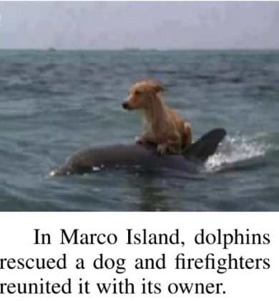
Introduction (2/2)
• What is Multimodal Fake News?
Multimodal Fake news is false or misleading news that mixes text ,images or other media to deceive people
It is essential to develop robust multimodal models capable of accurately detecting fake news

Slide 5


Motivation(1/2)
• Rising Spread of Misinformation
Fake news spreads rapidly on social media and strongly influences people’s beliefs and opinions.
• Serious Real-World Impact
It can lead to public confusion, harm health awareness, and create fear during critical situations.
• Need for Reliable Detection Tools
There is a strong need for intelligent systems to identify and limit fake news, in order to protect online trust.

Slide 6
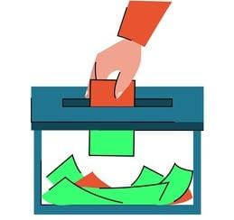
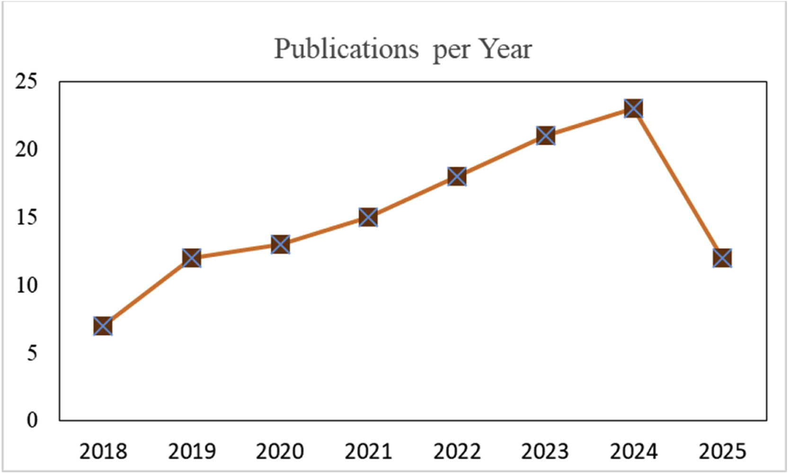
Motivation(2/2)
Ref.[8]
• COVID-19 Misinformation:
The graph highlights a notable rise in multimodal fake news detection publications since 2020, likely driven by the increased spread of misinformation during the COVID-19 pandemic.
• Election Misinformation
fake news spread to influence voters and damage candidates’ reputations, leading to mistrust in the political system.

Slide 7
Problem Definition
• Fake news on social media is becoming more complex, combining text, images
which makes detection more challenging.
• Most existing models focus only on text-based features and ignore visual content, while
multimodal models struggle to combine both effectively.
• Developing a hybrid multimodal model that mix text and image features can
significantly improve detection accuracy and reliability in real-world scenarios.

Slide 8

Objectives
• Develop a Multimodal Detection System
• Enhance Detection Accuracy
• Provide Transparent User Feedback
• Design a User-Friendly Web Interface

Slide 9
Literature Review – Paper 1
Ref.[1]
Title: Fake News Detection Using Machine Learning and Web Scraping Source: IRJET, Vol. 11, Issue 5, 2024
• Methodology
Collected live news from online sources.
Preprocessed text using NLP.
Trained models: Random Forest, Logistic Regression, KNN, etc.
Evaluated using Accuracy, Precision, Recall, and F1-score.
• Results
Random Forest performed best (Accuracy: 92%). Web scraping improved real-time detection and reliability.
• Research Gap
Relies only on text-based analysis.
No real user interface.
Lacks image or multimodal detection

Slide 10
Literature Review – Paper 2
Ref.[7]
Title: Multimodal Fake News Detection Progressive Fusion Networks
Source: (Elsevier), Vol. 59, Issue 6, 2023
• Methodology Extracted text features using BERT. Extracted image features using Swin Transformer, VGG19, and Discrete Fourier Transform (DFT). Applied progressive fusion through an MLP Mixer to combine shallow and deep features. Classified outputs into Fake or Real.
• Results Achieved 83.8% accuracy (Weibo) and 83.3% (Twitter). Outperformed previous models like SpotFake+, EANN, and MVAE by about 5%.
• Research Gap Model is computationally heavy and lacks
interpretability. Model can’t explain why a news item is fake or real.

Slide 11
Literature Review – Paper 3
Ref.[9]
Title: Multimodal Fake News Detection Using Fine-Grained Classification on the Fakeddit Dataset Source: Information (MDPI), 2022
• Methodology Used Fakeddit multimodal dataset (text + images).
Extracted text features using BERT.
Extracted image features using CNN models.
Combined features using feature fusion layer.
Performed classification into 2-way, 3-way, and 6-way labels.
• Results
Text-only models ≈ 74–78% accuracy.
Multimodal model ≈ 87% accuracy.
Multimodal outperformed unimodal approaches significantly.
• Research Gap
Many works rely only on text.
Limited research on fine-grained fake news categories. Model can’t explain why a news item is fake or real.

Slide 12
Literature Review – Paper 4
Ref.[6]
Title: Fake News Detection: An Image-Based Semi-Automated Method Source: AIP Conference Proceedings, Vol. 2461, 020012, 2022
• Methodology
Collected suspicious images using web crawling (Bing Search API).
Extracted statistical image features (mean, median, standard deviation for RGB).
Calculated similarity between images using Euclidean Distance.
Recommended the most relevant news sources to verify image authenticity.
• Results
Successfully identified false or misleading images in most cases.
Helped users verify fake images during the COVID-19 pandemic.
Tested on 4 image samples only — limited but promising.
• Research Gap
Relies only on images — no text or multimodal data.
Semi-automated, requires human review.
Small dataset and no quantitative accuracy metrics.
Uses basic statistical features, not deep learning or CNN-based methods.

Slide 13
Dataset
Ref.[5]
• In this work, we used the Fakeddit dataset.
• It contains 1 million multimodal fake news samples.
• Each sample includes text, images, and metadata.
• The data was collected from Reedit between March 2008 and October 2019.
• This dataset provides a realistic and diverse foundation for multimodal fake news detection.

Slide 14
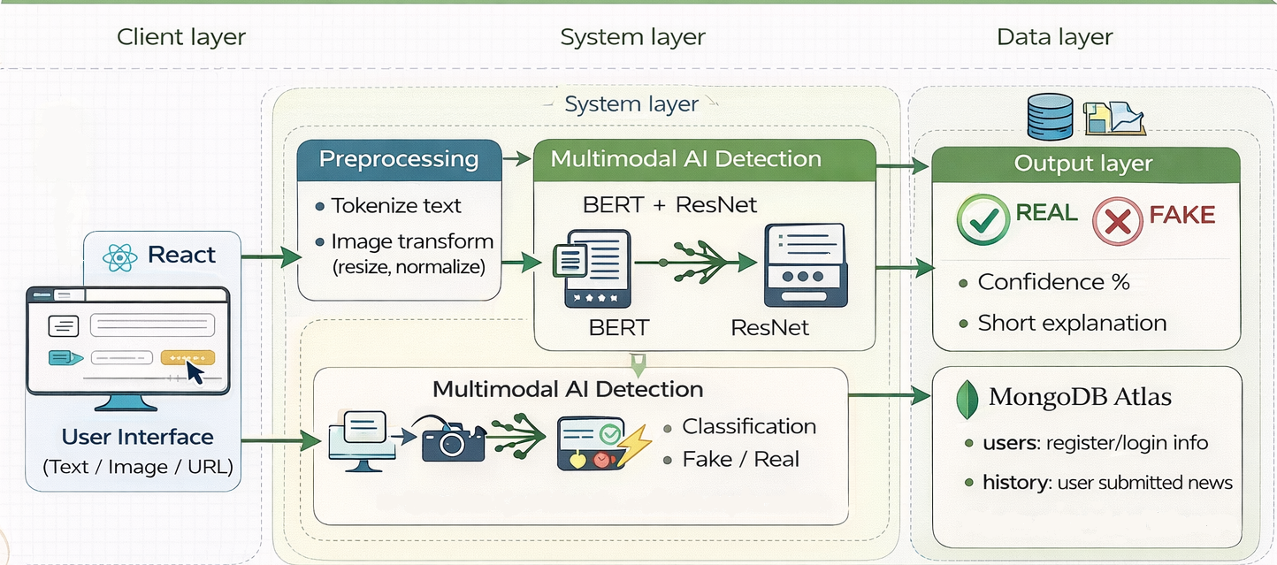
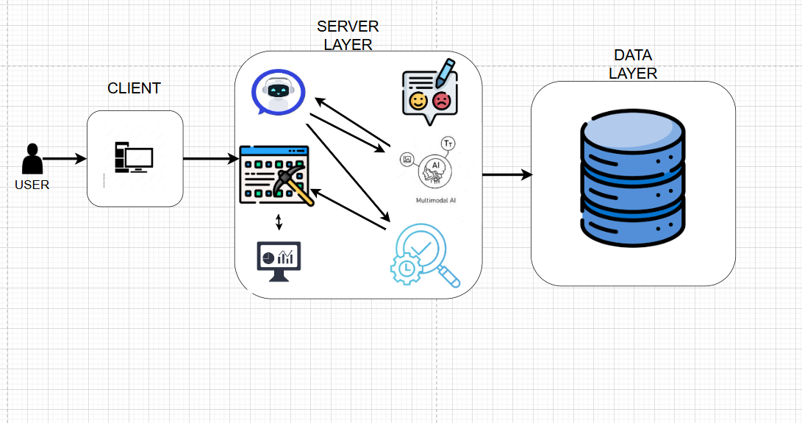
System Architecture

Slide 15
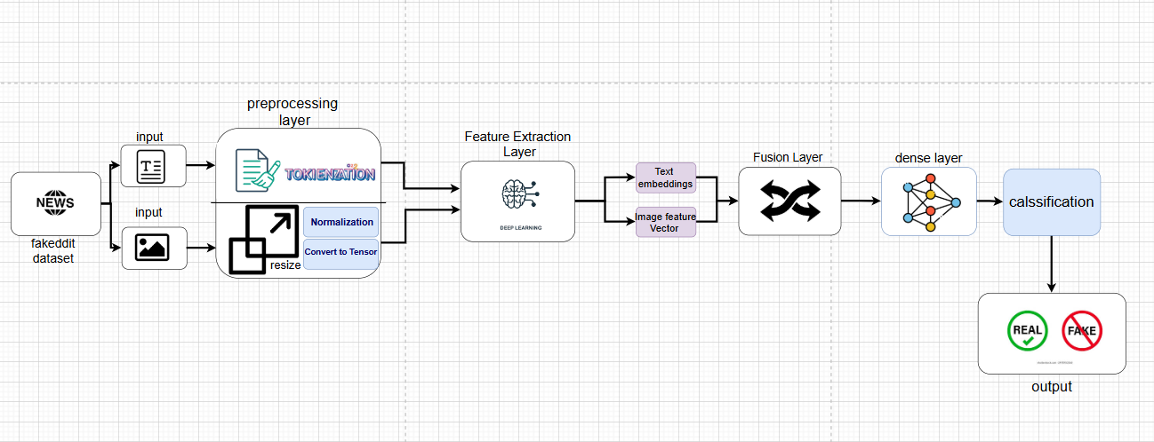
Model Architecture

Slide 16
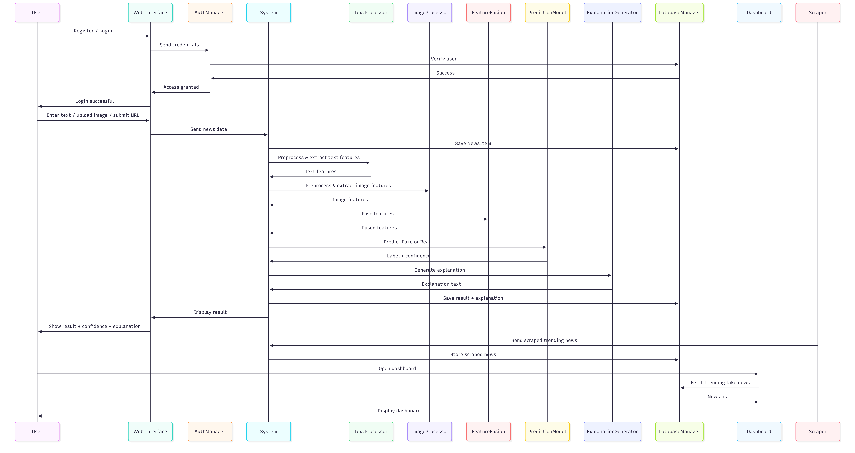
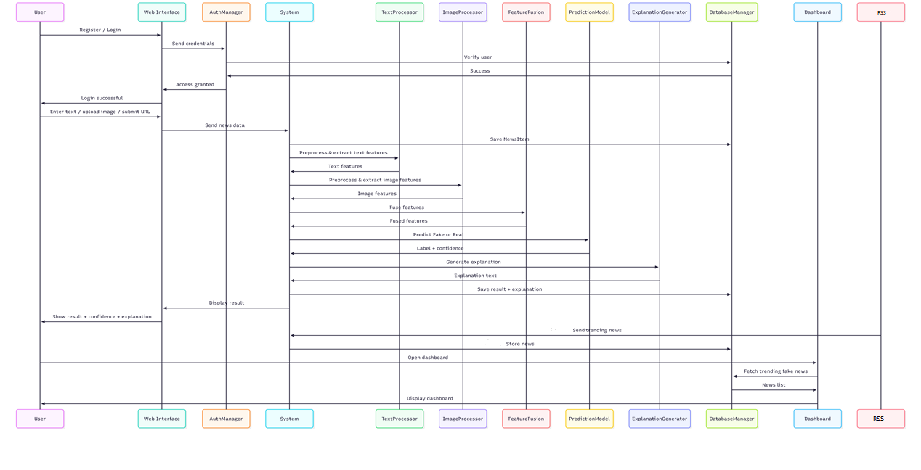
Sequence Diagram

Slide 17
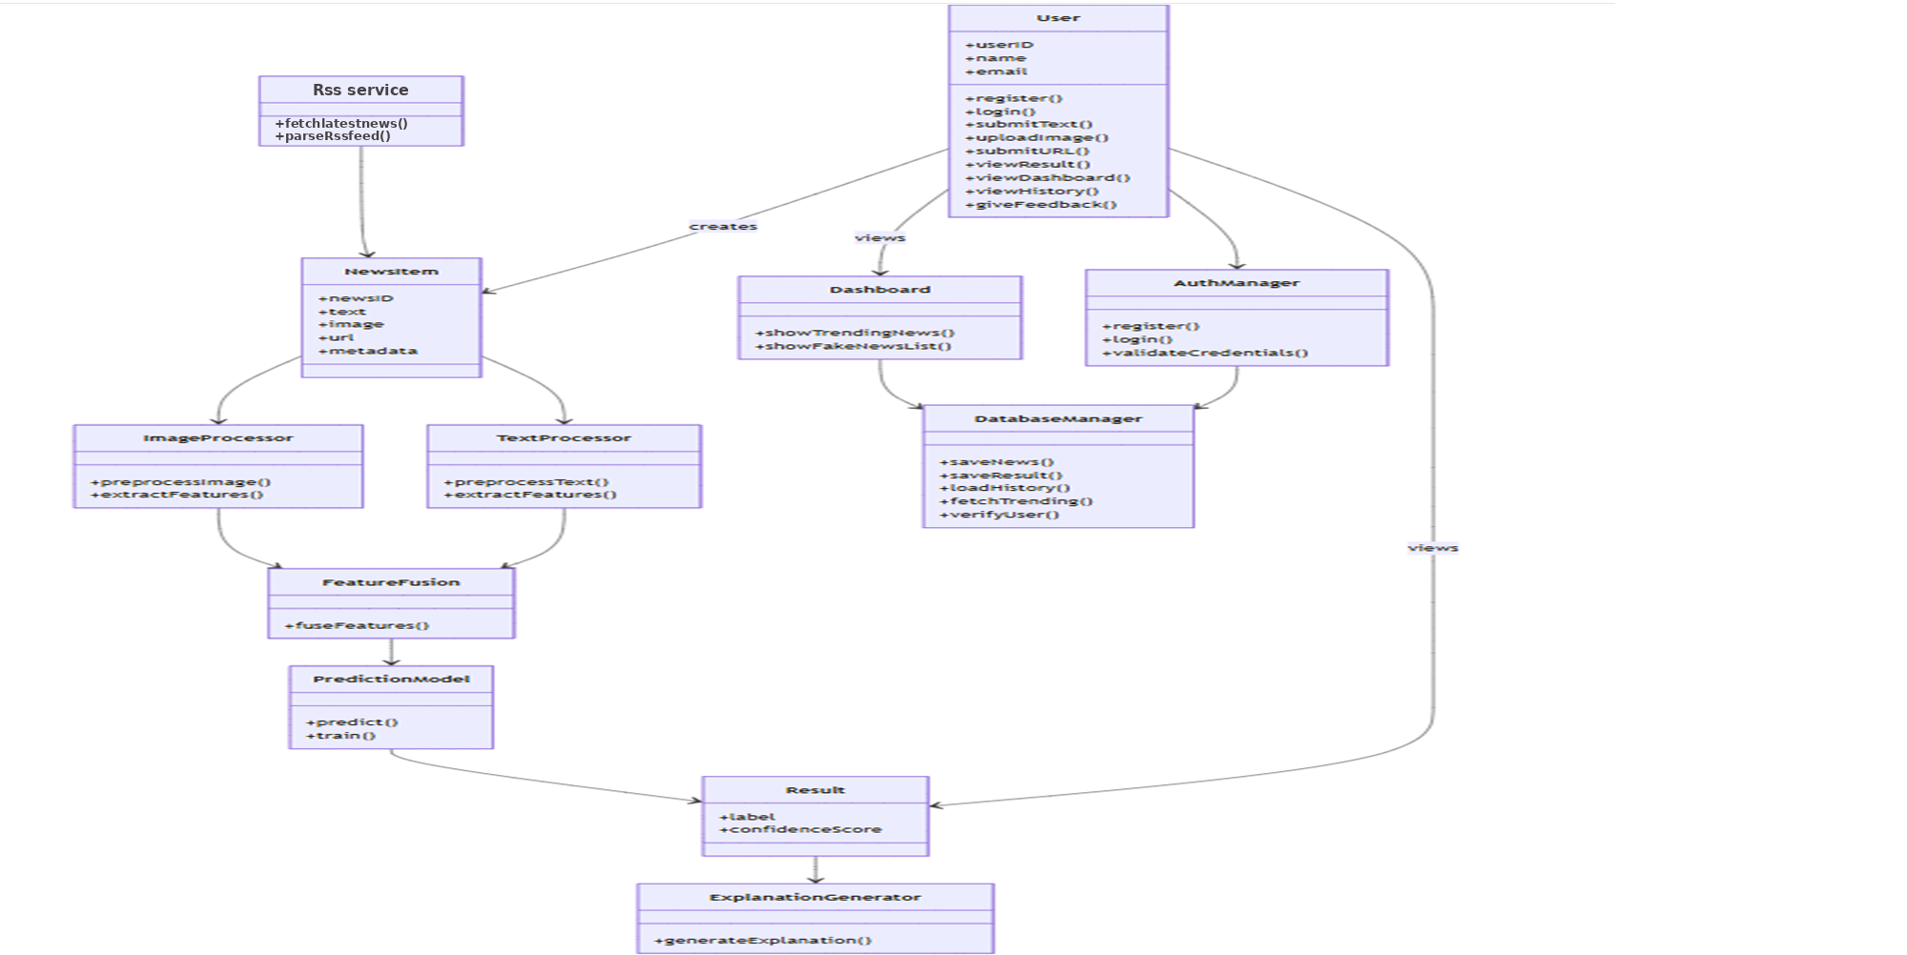
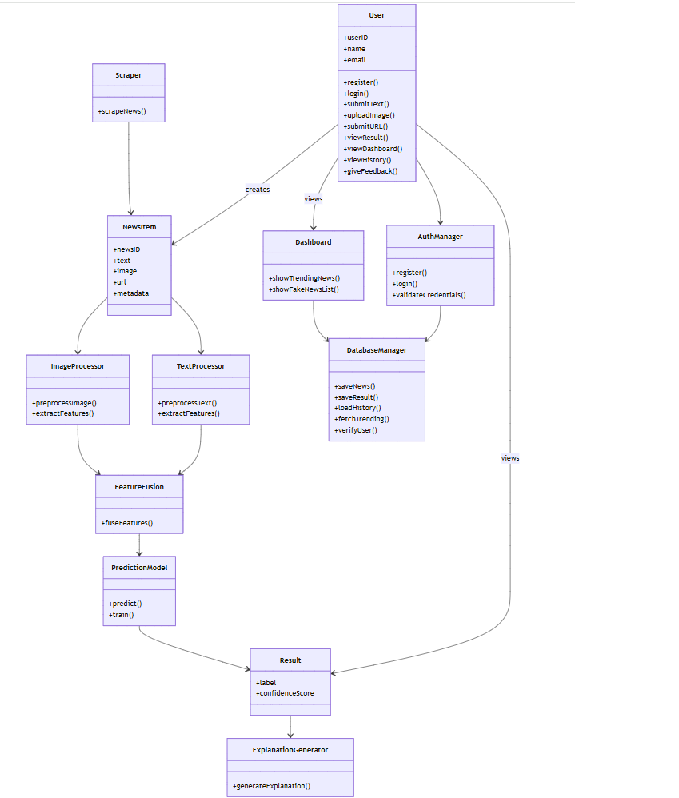
Class Diagram

Slide 18
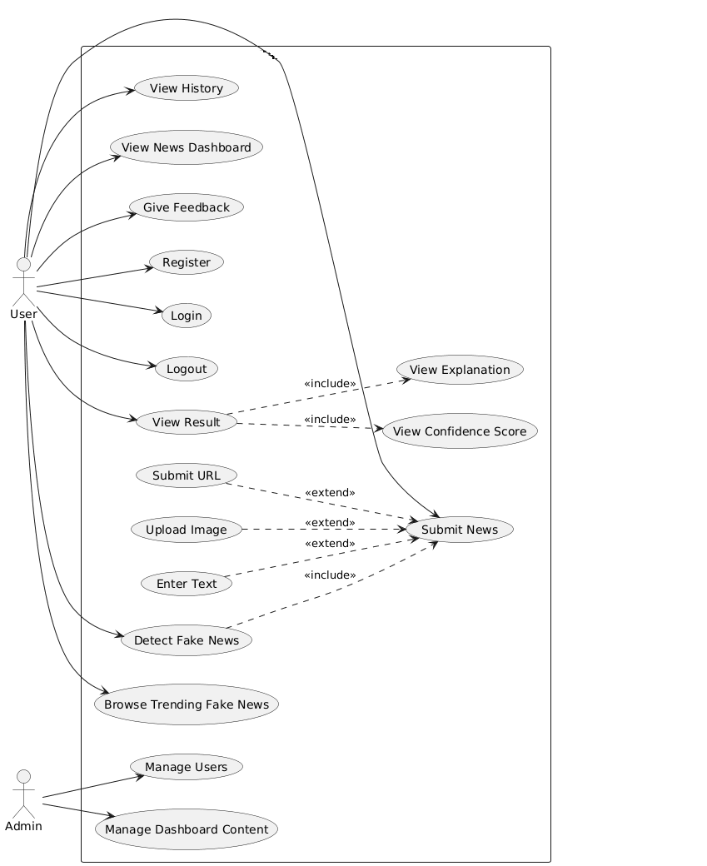
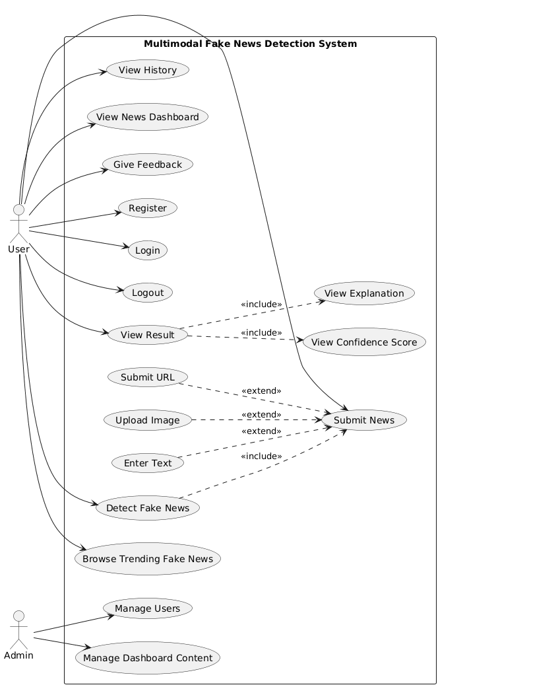
Use case Diagram

Slide 19
Model Overview
• Preprocessing and cleaning
• Training Strategy
• Evaluation Metrics

Slide 20
Preprocessing and cleaning
Removed samples with missing or broken image URLs.
Downloaded images and saved them using their unique IDs for consistency.
Deleted invalid rows where images failed to load or were corrupted.
Resize & normalize images

Slide 21
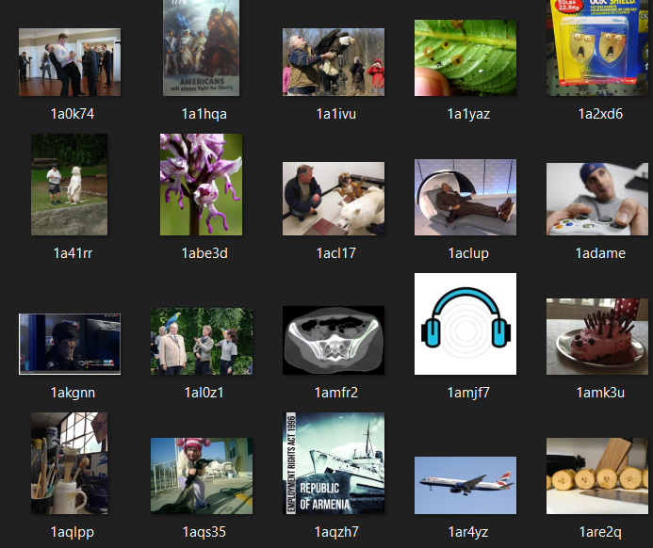
Sample pictures

Slide 22
Training Strategy
Used a multimodal architecture combining BERT (text) and ResNet-50 (image)
Applied a two-phase training strategy
Phase 1: Freeze backbone models and train only the classifier layers
Phase 2: Fine-tune selected layers of BERT and ResNet with a lower learning rate.
. Trained on a 5% dataset subset to reduce training time during experimentation.

Slide 23
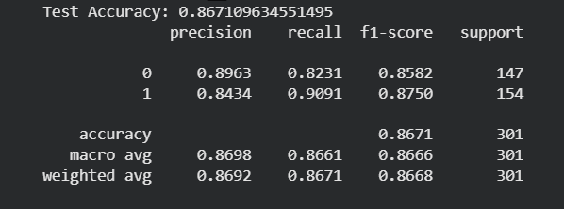
Evaluation Metrics

Slide 24
Design Patterns & Architecture
Service Pattern
Separates business logic from controllers
Improves code organization and maintainability Implemented through services such as: AuthService
DetectionService
AdminService
Layered Architecture
Organizes the system into independent layers:
Frontend Layer
Backend Layer
Database Layer
Model Layer
Benefits
Better code organization
Easier maintenance and development
Improved scalability
Flexible future model integration

Slide 25
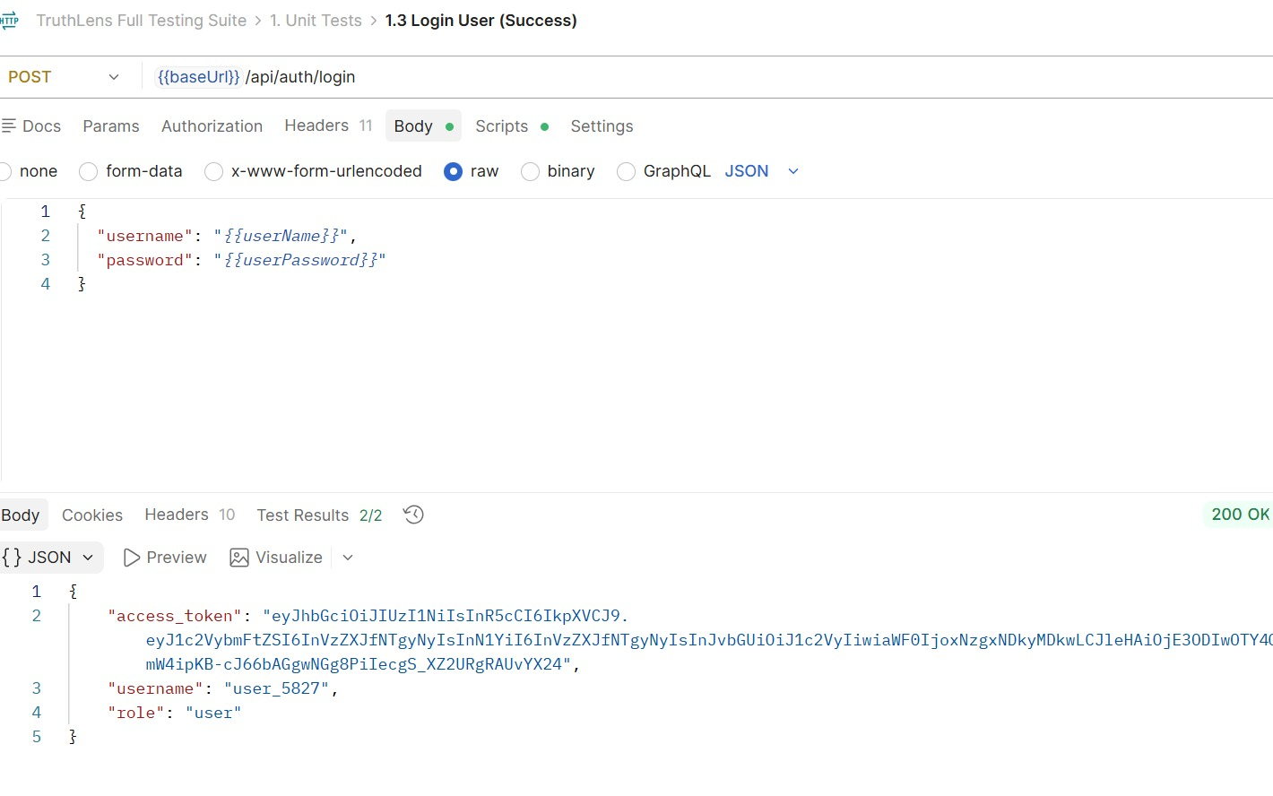
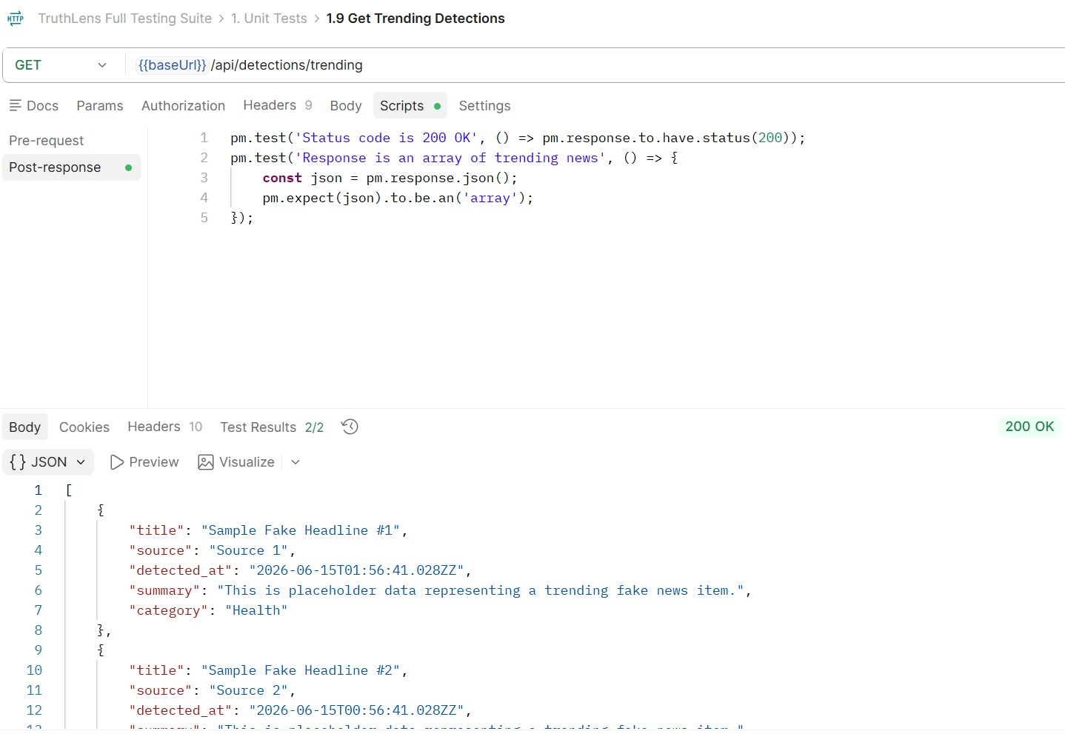
Unit Testing
Test ID | Test Case | Expected Result | Status
UT-01 | User Registration Validation | User input validated successfully | PASS
UT-02 | Login Validation | Valid credentials accepted | PASS
UT-03 | JWT Token Generation | Token generated correctly | PASS
UT-04 | URL Validation Function | Valid URL accepted | PASS
UT-05 | Prediction Result Formatting | Result displayed in correct format | PASS

Slide 26
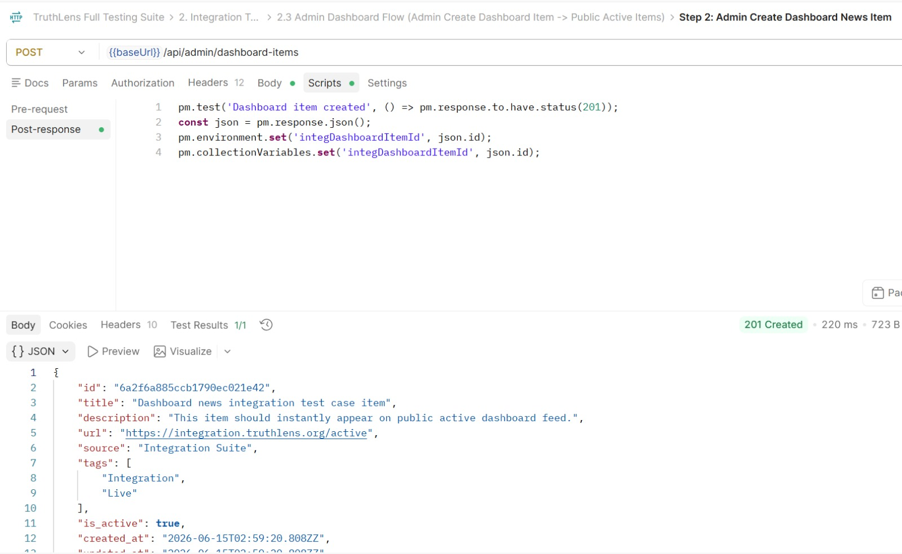
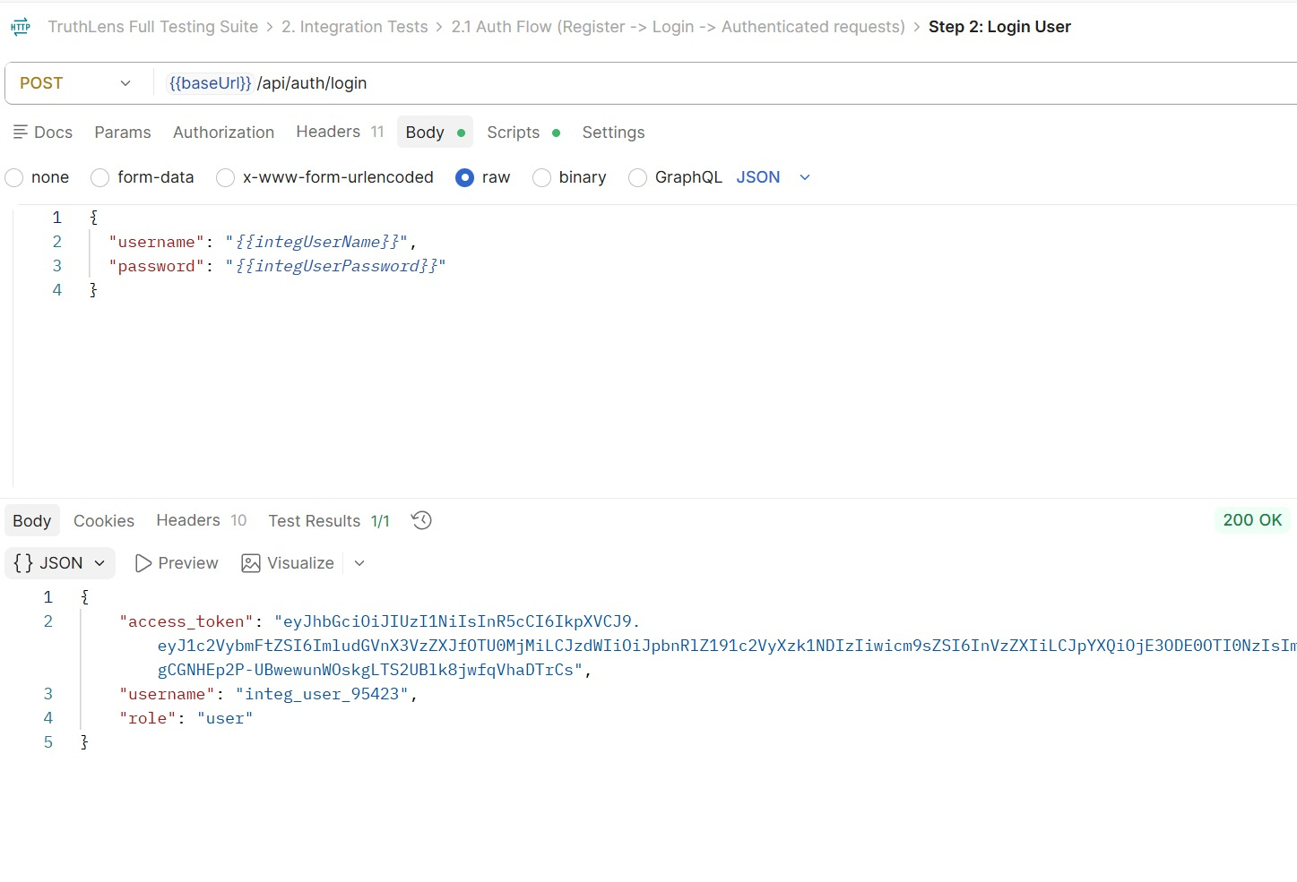
Integration Testing
Test ID | Test Case | Expected Result | Status
IT-02 | Login + JWT Authentication | User authenticated and token issued | PASS
IT-04 | Detection Module + History Page | New detection appears in history | PASS
IT-03 | Admin Dashboard + User Data | User information loaded correctly | PASS
IT-04 | Admin Dashboard + Detection Records | Detection records displayed correctly | PASS
IT-05 | JWT + Protected Routes | Authorized access granted | PASS

Slide 27
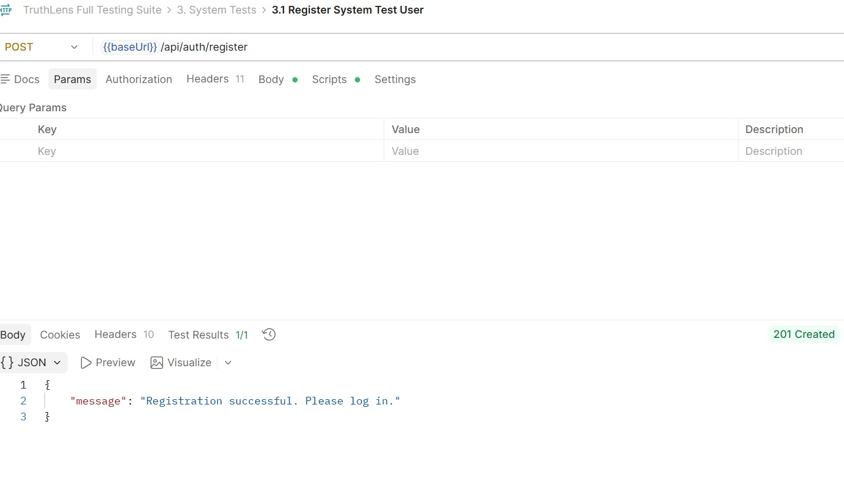
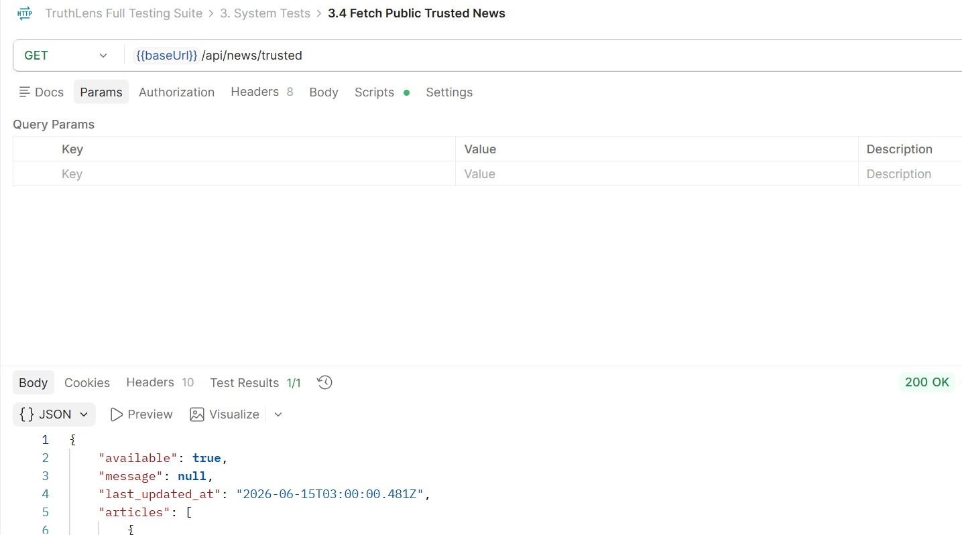
System Testing
Test ID | Test Case | Expected Result | Status
ST-01 | Complete User Registration Workflow | Account created successfully | PASS
ST-02 | Complete Login Workflow | User redirected to dashboard | PASS
ST-03 | Submit Text News for Detection | Prediction displayed successfully | PASS
ST-04 | Submit Image for Detection | Prediction displayed successfully | PASS

Slide 28
Bugs
Bug ID | Area | Bug / Issue Found | Actual Result | Expected Result | Status
BUG-01 | Detection Statistics | Stats endpoint returns different/missing field names, causing count tests to fail | total, initial count, and fake count returned as undefined in Postman | Stats should return clear counts such as total detections, real count, and fake count | Open
BUG-02 | Admin Authorization | Normal user can access admin stats endpoint | /api/admin/stats returned 200 OK | Normal user should get 403 Forbidden | Open
BUG-03 | Detection Result Details | Saved detection result classification does not match the expected test result | Result returned Real while test expected Fake | Retrieved result should match the saved detection classification | Open
BUG-04 | Dashboard Images | Images in the TruthLens dashboard are not displayed correctly | Image area appears empty or broken | Uploaded/detected images should appear correctly in the dashboard | Open
BUG-05 | API Error Response | Some failed requests do not return a clear error message | Error message returned as undefined | Backend should return a clear error message for failed/unauthorized requests | Open

Slide 29
Challenges
Challenge | Explanation
AI Model Integration | Connecting the trained AI model with the website instead of using random or placeholder results.
Multiple Services Communication | Making React, NestJS API Gateway, FastAPI AI service, and MongoDB work together correctly.
API Endpoint Errors | Fixing errors such as 404 Not Found, 400 Bad Request, and wrong endpoint paths.
File Upload Issues | Handling image, and text uploads correctly using form-data.
Unexpected Field Error | Matching the frontend/Postman file key with the backend FileInterceptor field name.
JWT Authentication | Testing protected endpoints using Authorization: Bearer <token> in Postman.
Detection History | Saving detection results in MongoDB and displaying them correctly on the website.
Port Conflicts | Solving backend port errors such as EADDRINUSE when a port was already in use.
Full System Testing | Testing the complete flow: login → detect → save history → view history.

Slide 30
Requirements
• Hardware Requirements
No special hardware components are required for this project.
The system is entirely software-based and can run on any standard computer.
• Software Requirements
-Programming Language: Python
-Framework: PyTorch or TensorFlow (for building and training deep learning models)
-Database: MongoDB (for storing and managing news data and model outputs)

Slide 31

Future work
Train the model on the full dataset to improve performance.
Improve generalization using external fake news datasets.
Enhance multimodal fusion techniques for better accuracy.
Develop the dashboard using Rss.

Slide 32
Project Time Plan
Phase | Duration | Progress | Key Milestone
Phase 3 – Model Improvement & Tuning | Feb – Mar | 40% | Fine-tune multimodal model and improve generalization.
Phase 4 – External Data & Robustness | Mar | 25% | Add external datasets and handle real-world inputs.
Phase 5 – Dashboard & Rss | Mar – Apr | 15% | Implement fake news trends dashboard.
Phase 6 – System Integration | Apr | 20% | Connect model with backend APIs.
Phase 7 – Testing & Optimization | Apr – May | 10% | Performance testing and bug fixing.
Phase 8 – Deployment | May | 5% | Deploy system and model.
Phase 9 – Documentation & Final Presentation | May – Jun | 10% | Final report and graduation presentation.

Slide 33
Work Division & Responsibilities
Member | Key Contributions
Omar Aly | Designed website interface and backend. Linked model with website. Handled database and documentation.
Ahmed Waleed | Designed and trained ML models (text & image). Implemented Rss and preprocessing. Improved model accuracy and testing.
Both | Worked together on dataset collection, testing, and final evaluation

Slide 34
References
[1] “Fake News Detection Using Machine Learning and Web Scraping,” International Research Journal of Engineering and Technology (IRJET), vol. 11, no. 5, May 2024
[2] Khanam, Z. et al., “Fake News Detection Using Machine Learning Approaches,” IOP Conf. Ser.: Mater. Sci. Eng., Vol. 1099, 2021.
[3] I. Segura-Bedmar and S. Alonso-Bartolome, “Multimodal Fake News Detection,” Information, vol. 13, no. 6, p. 284, Jun. 2022
[4] J. Jing, H. Wu, J. Sun, X. Fang, and H. Zhang, “Multimodal fake news detection via progressive fusion networks,” Information Processing & Management, vol. 60, no. 1, p. 103120, Jan. 2023
[5] K. Nakamura, S. Levy, and William Yang Wang, “r/Fakeddit: A New Multimodal Benchmark Dataset for Fine-grained Fake News Detection,” arXiv (Cornell University), Nov. 2019
[6] E. A. Lisangan, A. L. Tungadi, and F. Wibowo, “Fake News Detection: An Image-Based Semi-Automated Method Using Statistic Feature,” AIP Conference Proceedings, vol. 2578, no. 060002, pp. 1–8, Nov. 2022
[7] N. M. Duc Tuan and P. Quang Nhat Minh, "Multimodal Fusion with BERT and Attention Mechanism for Fake News Detection," 2021 RIVF International Conference on Computing and Communication Technologies (RIVF), Hanoi, Vietnam, 2021
[8] Skafle I, Nordahl-Hansen A, Quintana D, Wynn R, Gabarron EMisinformation About COVID-19 Vaccines on Social Media: Rapid ReviewJ Med Internet Res 2024;24(8):e37367
[9] I. Segura-Bedmar and S. Alonso-Bartolome, “Multimodal Fake News Detection,” Information, vol. 13, no. 6, p. 284, Jun. 2022, doi:.

Slide 35


Slide 36
Why fakeddit?
Feature / Point | FakeNewsNet | Fakeddit | Twitter Dataset
Source | PolitiFact + BuzzFeed | Reddit (posts, memes, comments) | Twitter (tweets, retweets, hashtags)
Modalities | Text + limited/broken images | Text + Image + Metadata | Text only
Data Size | ~23K articles | 1.06M+ posts | ~100K tweets
Labels | Binary (Real / Fake) | 6-class (can be merged to binary) | Binary (Fake / Real)
Strengths | Verified, fact-checked news | Large-scale, multimodal, diverse | Real-time social data
Gap / Limitations | Small and outdated, many missing images, limited to politics | Some noise and informal Reddit posts | Text-only, short and noisy tweets, lacks visual context
Why Choose Fakeddit? | Limited & not multimodal | Best for multimodal deep learning (text + image) | Text-based only,

Slide 37
Metadata?
Field | Example Value
Post ID | 10234
Title | NASA confirms water on Mars!
Text (Summary) | NASA scientists discovered traces of frozen water beneath the Martian surface.
Image URL | https://i.redd.it/marswater.jpg
Source / Subreddit | r/space
Author / User | u/astro_life
Publish Date | 2022-06-15
Upvotes / Score | 4200
Num. of Comments | 560
URL / Link | https://reddit.com/r/space/10234
Label (Verdict) | ✅ Real
c

